Slide 1
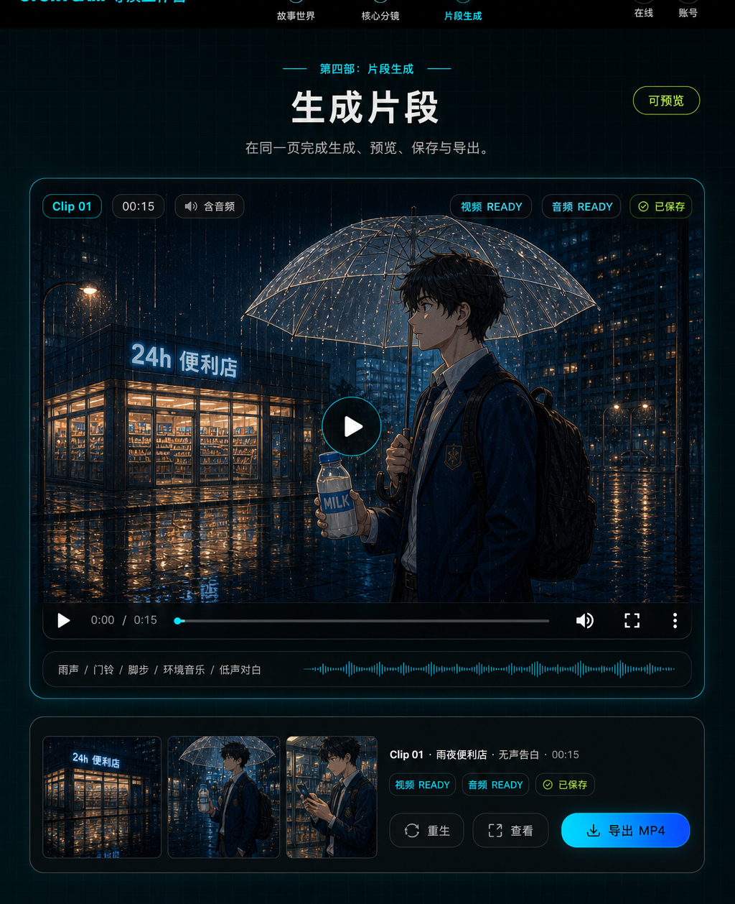
INVESTOR DECK V0.1
StoryCam
AI 私人小剧场
把私人念头
拍成一段可保存的小电影。
普通用户不需要学习分镜、prompt 或剪辑软件。StoryCam 先让故事、人物、地点和核心时刻被确认，再生成真实片段并保存为 final work。
01
09
15s
PRIVATE IDEA
CONFIRMED FRAMES
GENERATED CLIP
一句话、照片、回忆或角色幻想
视频前看见这一段会怎样拍
账号内保存、预览、导出 MP4
Source: StoryCam product specs and local design assets.
01

Slide 2
WHY NOW
Consumer AI 已经形成使用习惯，但付费机会还在专业化场景里。
投资人现在会追问：AI 到底创造了什么独特价值、用户为什么会留存并付费、产品是否有明确的资本效率路径。
1.7-1.8B
~3%
736M
全球 AI 用户
付费渗透
CapCut mobile MAU
Menlo 估算：AI 已从实验转为大规模习惯形成。
消费 AI 收入约 $12B，低付费率代表专业化工具空间。
a16z 将视频编辑等 AI-native/AI-core 消费场景纳入榜单。
StoryCam 的 wedge：不是再做一个通用 AI 视频工具，而是把“私人故事 + 情绪确认 + 可保存成片”做成一个高频、低门槛、可付费的消费体验。
Sources: Menlo Ventures State of Consumer AI 2025; a16z Top 100 Gen AI Consumer Apps, 6th ed.; Carta 2025 review.
02

Slide 3
PROBLEM
用户不缺 AI 生成按钮，缺的是一个会把情绪导演成故事的产品。
普通用户的真实阻碍
StoryCam 的产品回答
不会写剧本
先生成可读短剧本，让用户确认“像不像我的故事”
不懂镜头语言
把专业导演脑藏在内部，只展示“这一段会这样拍”
害怕浪费视频成本
视频前确认人物、地点、9 帧分镜，再启动真实 clip job
担心私人素材
账号范围保存，provider 调用走 server-side 边界
产品判断
StoryCam 应该像“私人小剧场相机”，而不是工业化短剧生产后台。
Sources: StoryCam product vision and MVP specification.
03

Slide 4
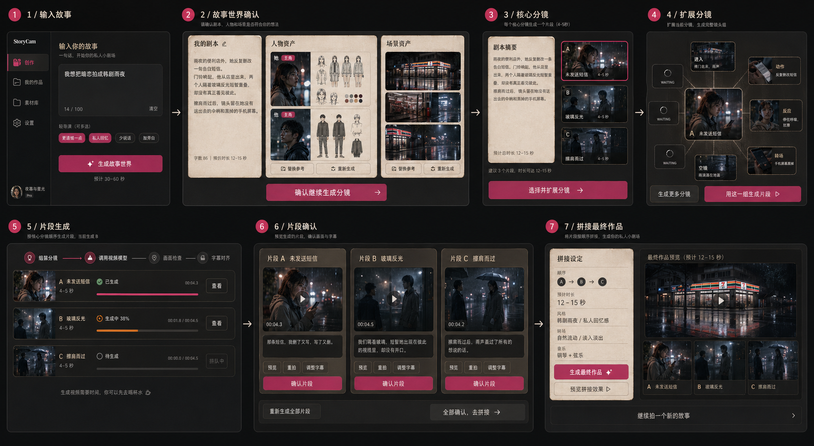
PRODUCT LOOP
StoryCam 在昂贵的视频调用前，先把故事变成可确认的世界。
投资人希望尽早看到产品。这里的核心不是一张生成图，而是从输入到 final work 的确认链路。
1
输入私人念头
2
确认故事世界
3
确认核心分镜
4
扩展 8 张指导卡
5
生成 clip + final work
Source: verified StoryCam UI flow board in docs/design-docs/assets.
04

Slide 5
SYSTEM
The product is an artifact graph, not a prompt wrapper.
每个节点都能被用户确认、被账号保存、被后续生成复用；provider 调用只发生在 server-side 边界后。
Idea
World
Storyboard
Clip Job
Final Work
私人念头
+ optional photos
script
characters
scene
1 core group
9 frame script
Seedance job
async state
saved preview
MP4 export
Trust boundary
浏览器不直接调用模型或媒体 provider；raw prompt、provider payload、signed URL 与专业分镜表都不暴露给普通用户。
Server-only orchestration
Supabase Auth + Postgres + private Storage + generation_jobs + provider adapters
Sources: docs/ARCHITECTURE.md, docs/SECURITY.md, StoryCam MVP spec.
05

Slide 6
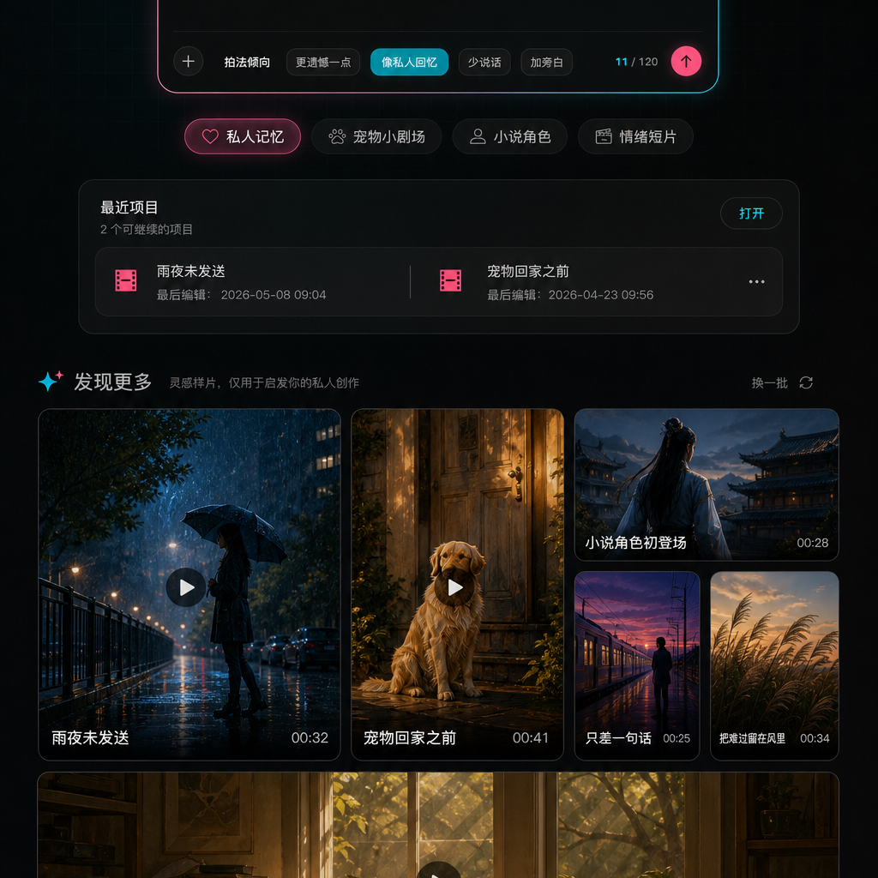
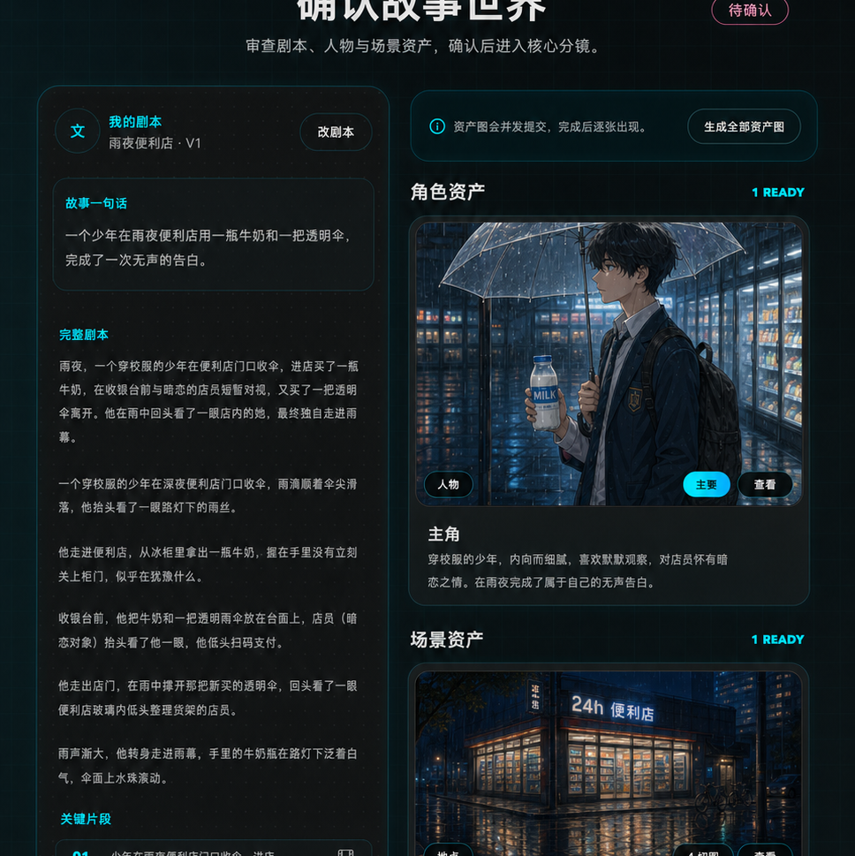
PRODUCT SURFACE
The MVP already feels like a cinematic workstation, not a template generator.
1 / 输入故事
2 / 故事世界
5 / 片段生成
低摩擦开始：一句话、照片、轻导演选择
剧本、人物、地点资产先被确认
同页预览、重拍、保存和 MP4 导出
Source: verified current UI screenshots from docs/design-docs.
06

Slide 7
BUSINESS MODEL
Revenue starts at the moment the story becomes worth keeping.
先用低成本预览建立情绪确认，再把用户愿意保存、高清导出、延展角色故事的时刻商业化。
Free / low cost
Paid moment
Subscription
Future
story world
character card
key frames
10-15s clip
HD / no watermark
MP4 export
longer theater
saved characters
style packs
couple / pet / trip
memory templates
private archive
验证“像不像我的故事”
用户想保存时付费
持续角色与故事资产
高情感场景包
Investor check to add
Pricing, gross margin per clip, export conversion, repeat creation, and retention are intentionally left open until product data exists.
Sources: StoryCam product vision monetization notes; DocSend 2026 business-model guidance.
07

Slide 8
MOAT
The defensibility is taste, trust, and private story memory compounding together.
01
Taste layer
cinematic UI, private mini-theater language, emotional templates
Why it is hard to copy
02
Workflow layer
story -> assets -> storyboard -> clip -> final work confirmations
A generic video model can make clips. StoryCam's advantage is the repeated user-specific confirmation data and the taste layer around private emotional stories.
03
Memory layer
account-scoped story sessions, character/scene assets, recent projects
Each saved story improves the user's next story-world, character continuity, and willingness to pay for the finished moment.
04
Trust layer
server-side providers, private storage, redacted logs, no raw payloads
Sources: StoryCam architecture, privacy, design, and product-sense docs.
08

Slide 9
ROUND PLAN
This round should buy proof that users come back to make the story more theirs.
The deck is intentionally light until traction, team, and ask details are added. The next investor version should insert exact metrics, not invented placeholders.
0-3 mo
3-6 mo
6-12 mo
12-18 mo
Repeatable MVP magic
Paid export tests
Retention loops
Series A evidence
real clip success, felt-like-mine feedback, save/export intent
HD/no-watermark, credits, template packs, early gross margin
saved characters, recent projects, story archives, weekly templates
cohort retention, paid conversion, cost per finished work
Ask to insert
Round size, runway target, use-of-funds split, team bios, and prior capital.
Metrics to insert
story_world_confirmed, expansion_used, clip_generation_confirmed, save_intent, retry_intent.
Sources: YC seed fundraising guide; DocSend 2026 seed deck guidance; StoryCam success metrics.
09

